Slide 1
Mainstream/Underground
Presentation
By: The rona kids

Slide 2
Updated Lense - Mainstream vs Underground
Mainstream:
Based on popularity - streams and going viral
US and Global Top 50 charts
Spots on popular playlists
Not restrictive in topics or sound
More solo artists with features
Focus on party vibes
Underground:
Opposite of mainstream
Underground artists don’t have the platform of a mainstream artist
Underground artists typically aren’t in pop culture
Topics and flow can be similar to mainstream artists

Slide 3
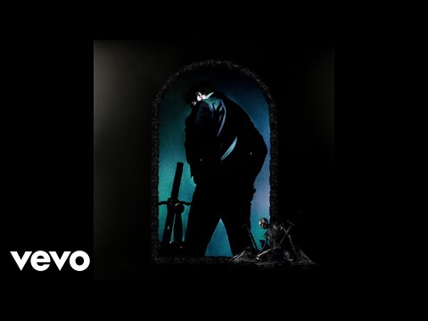
Mainstream 1 - A Thousand Bad Times by Post Malone
Said you needed a ride, but you wanted my car
Without that face, girl, you wouldn't get far
I really like you, despite who you are, oh (who you are)
You see me on tv, you know I'm a star
You say you don't know me, but I know that's false
I'll pay the price, girl, whatever that cost (what it cost?)
You make my life so hard
But that's what gets me off
I had a thousand bad times
So what's another time to me? (What's that time, yeah)
You try to burn my house down
But what's another house to me? (What's that time, yeah)
'Cause I can take anything that you give me (what you give me)
It's gonna take a lot more to kill me, bitch
So thank you for the grave (yeah)
I needed me a place to sleep (place to sleep)
Notes:
Has over 10 million views
42 million monthly listeners on spotify

Slide 4
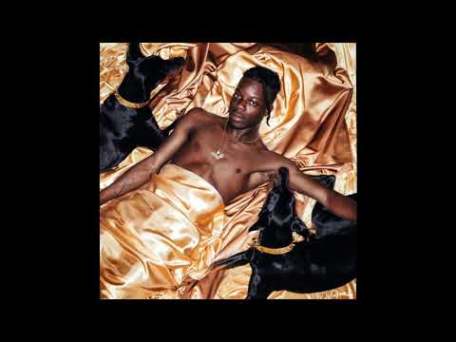
Underground 1 - Drugs and Whatever You Want by Thutmose
I think about it all the time
Love your jewelry and all your clothes
You won't be needing them tonight
So baby leave 'em all at home
We can hit magnolia
Cruising in the rover
I just wanna show ya
How I'm gunna how I'm gunna how I'm gunna love ya
Lemme get to know ya
I've been waiting for ya
I've been waiting for your love
Let me take you out, 5 star meals
Champagne bottles, drugs and whatever you wanted
Cuz you deserved whatever you wanted
Meet me at JFK, go to Cali on a red eye
Hotels naked, drugs and whatever you wanted
Cuz you deserve whatever you wanted
You deserve whatever you want
Notes:
41 thousand views
1 million monthly listeners on spotify

Slide 5
Compare: Post Malone and Thutmose
A Thousand Bad Times
Has more streams and view - 42 and 10
Artist is well known
Sad about previous failed relationship
Melancholy tone
Intense, dark vibes
Drugs and Whatever You Want
Has less streams and views - 1 and 42k
Artist is not well known
About being in love and what he wants to do for her
Happy tone
Immaculate vibes

Slide 6

Mainstream 2 - Pain 1993 (with Playboi Carti) by Drake
Racks all in my jeans and they Raf Simons (Racks in my jeans, okay)
Diamonds all in my teeth, I called up the dentist, yeah (Okay)
Got a Goyard bag, I threw them racks in it (My racks, yeah)
Every time I'm home, you know I whip the Bentley (Yeah, yeah, yeah)
I just threw these pills in my cup, yeah, yeah (Just threw these pills, uh)
Shawty just pulled up just to get fucked (Shawty just pulled up)
But I only want top, yeah, for sure (Only want top)
And I know I'm on top, but I want more (Okay)
Remember I used to sleep on the floor (With my, oh yeah)
Now every day I rock Christian Dior (Okay, Dior, yeah)

Slide 7

Underground 2 - 556 by Comethazine
We can get it crackin', bitch I live for action (Yeah)
Came in with the AK-47, fully automatic (Boom, bitch)
Everything is new, yeah, I'm the first to use (That's right)
Real killers don't need face tattoos, I'm the first to prove
I got too much to do, I need another day
Bitch, I'm locked up in the stu', I got too much to say
Big .9, I can't wait to shoot, I keep it tucked away (Boom)
This time, I will nut on her face, she said she like the taste
Recline, bust a nut in her mouth, she took it to the face (Come here)
Yeah, police led me on the chase, but still, I got away

Slide 8
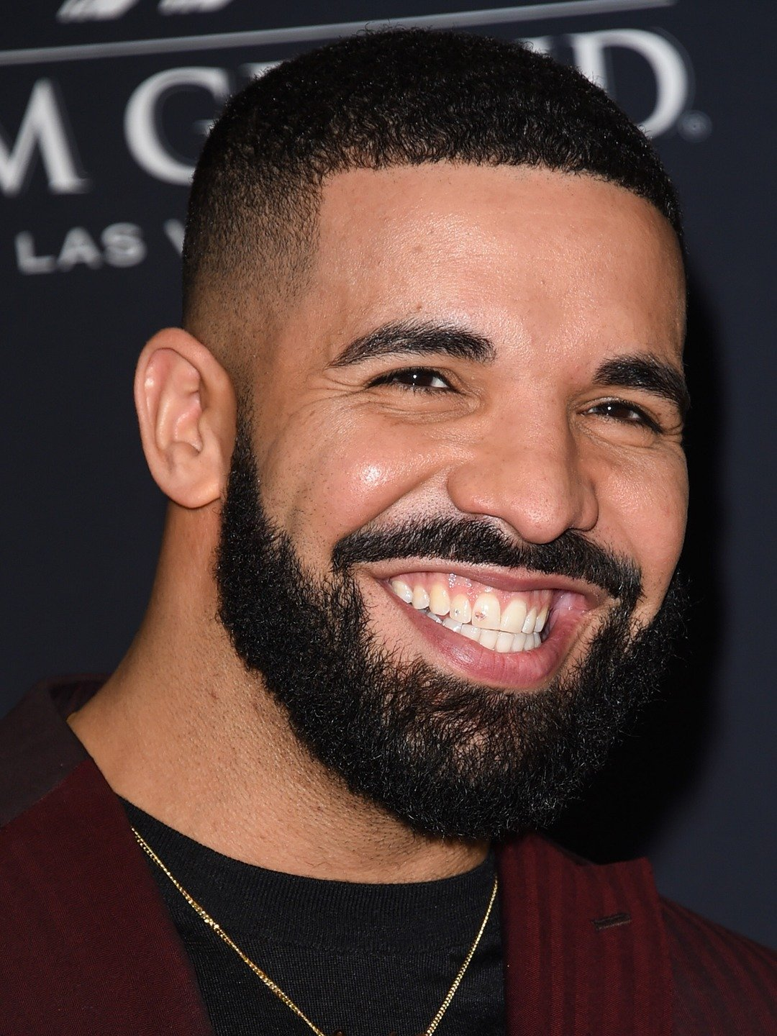

Drake and Comethazine Comparison
It not a difference between theme and quality of work
All dependent on the platform
Drake:
Get numerous features from anyone in the industry
Has easy access to top producers, audio engineers, and other important figures
Make multi-million dollar deals with companies
Has name recognition just about anywhere
Comethazine:
Doesn’t have a large platform
Isn’t recognizable enough for making large deals
Still makes quality music despite the small platform
Both:
Could make similarly sounding (hard) music
Could put out their best work and talent
Could change their style and image
Could adapt to the industry

